Slide 1

STOCK PRICE PREDICTION USING MACHINE LEARNING
VINAY PANDEY - SEC A - ROLL NO. 71
UNIVERSITY ROLL NO. 2019229
MENTOR - DR. SACHIN SHARMA , PROFESSOR

Slide 2
INTRODUCTION
The stock market is a highly popular investment option due to the potential for significant profits. Throughout history, as trading and investing have expanded, people have sought out tools, methods, and techniques to maximize their returns while minimizing risk.
The stock being analyzed for value prediction is that of Apple Inc., which is traded under the ticker symbol AAPL on both the Nasdaq Composite Index and the S&P 500 Index. Additionally, AAPL can be bought and sold on various other platforms, including the New York Stock Exchange
Stock market prediction is the process of forecasting the future performance of a particular stock or the overall stock market. This is typically done using various analytical and statistical methods to analyze historical price and volume data, as well as market trends, economic indicators, and other relevant factors

Slide 3
The primary objective of this project is to develop a machine learning model that can utilize a company's past stock data to generate predictions of its future prices. This predictive capability would be of great assistance to potential investors seeking to make informed decisions regarding the stock in question.
Tasks such as risk management, economic forecasting, and trading can be facilitated by this application, making it a valuable resource for stock investors, sellers, buyers, brokers, businesses, companies, and government agencies.

Slide 4
METHODOLOGY
PYTHON
JUPYTER NOTEBOOK
TENSOR FLOW
TOOLS AND TECHNOLOGIES USED
NUMPY
PANDAS
MATPLOTLIB

Slide 5
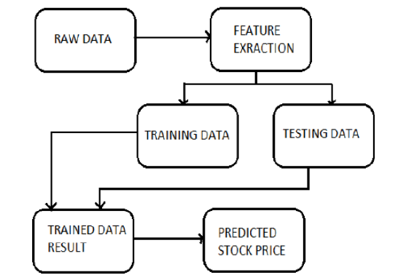
PROPOSED WORKFLOW
The system of this project here is composed of five main steps:-
1. Input as Dataset
2. Pre-processing – Train and Test
3. Build & Model train a Stacked LSTM Model
4. Predicting the test data and plotting the output
5. Predict the future 30 days and predict the output

Slide 6
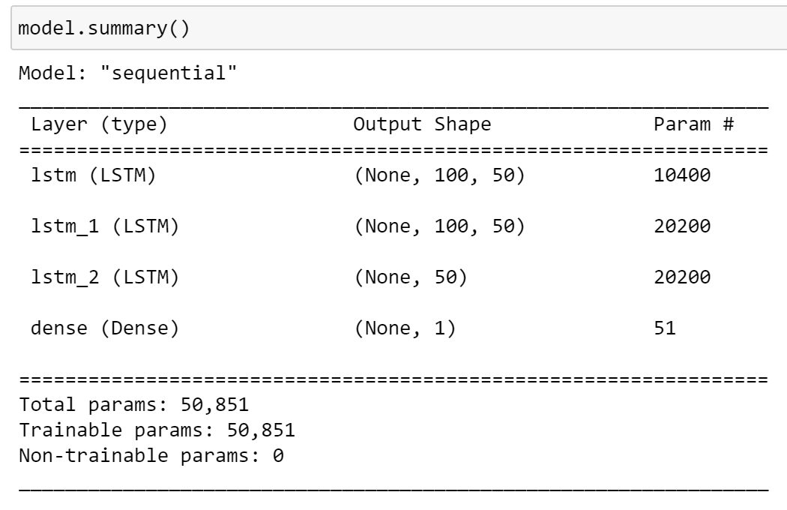
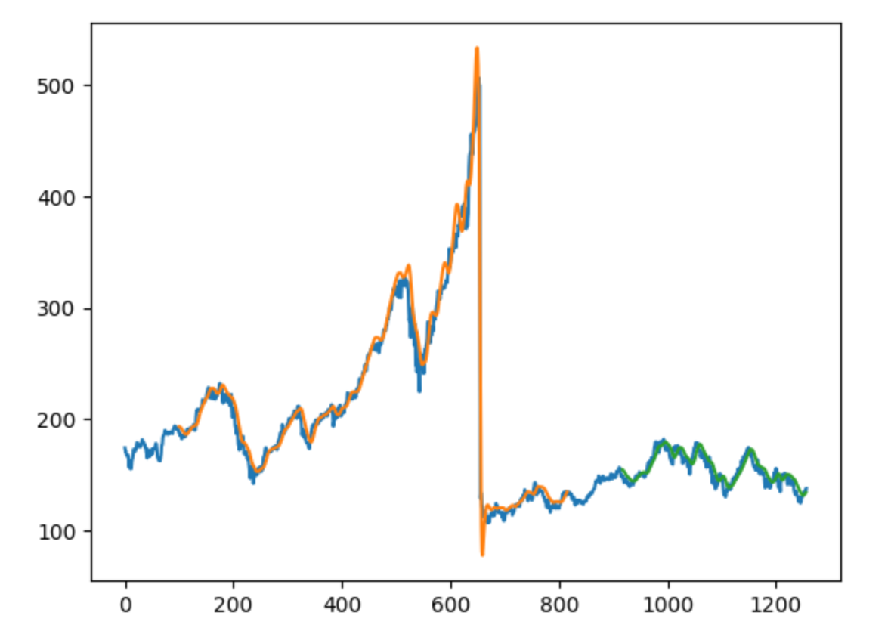
Data pertaining to the prices of Apple's stock has been acquired from a website called Tiingo, utilizing an API key assigned to the user. Subsequently, the data is appropriately scaled and divided into separate training and testing datasets, upon which a Stacked LSTM model is constructed.
The above figures show a summary of the Stacked LSTM Model and the prediction of model on testing data respectively.

Slide 7
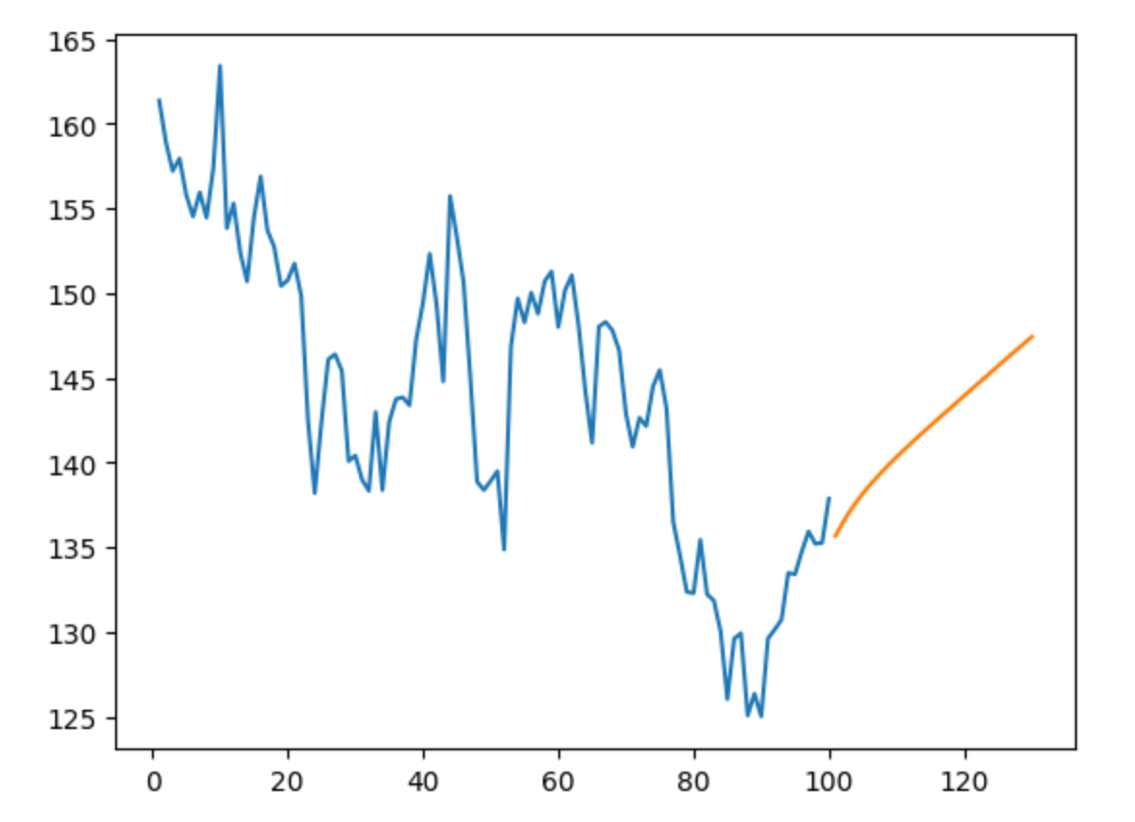
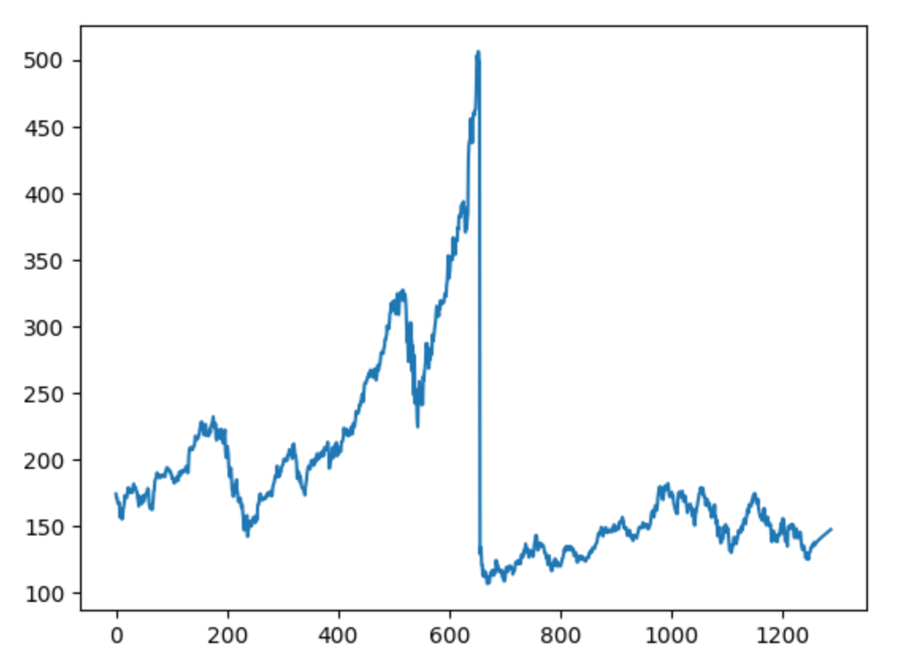
RESULT AND DISCUSSION
By following the described methodology, a stacked LSTM model was developed and trained on a dataset of Apple stock prices obtained from a .csv file and Tiingo data. Utilizing this model for forecasting the stock price for the next 30 days results in the output shown below.
PREDICTION OF MODEL FOR NEXT 30 DAYS
OVERALL GRAPH OF STOCK DATA WITH THE PREDICTION

Slide 8
The implementation of this deep learning model has the potential to assist numerous investors in making sound investment decisions, thereby enhancing their profitability within the stock market. Nonetheless, despite the prevalence of various highly accurate machine learning models, it is essential to recognize that the stock market is inherently unpredictable and volatile in nature. Therefore, investors should conduct thorough research and analysis before committing any capital, and not solely rely on these systems for financial decision-making.

Slide 9
CONCLUSION AND FUTURE WORK
Through this project, I have developed a system that can forecast the stock value for up to the next 30 days. This system has the potential to aid investors in making informed decisions and increasing their overall profitability in the stock market
However, it is important to note that financial decisions should not be solely based on machine learning models as the stock market is highly unpredictable and volatile. It is necessary to conduct thorough research before investing.
Although numerous machine learning models with high accuracy rates are available, this model can be further enhanced in future work. Improvements can be made by expanding the input dataset, increasing the number of epochs, and implementing bi-directional LSTM instead of stacked LSTM to achieve better accuracy.

Slide 10
THANK YOU

